Slide 1
Lecture 2 Multithreaded Programming

Slide 2
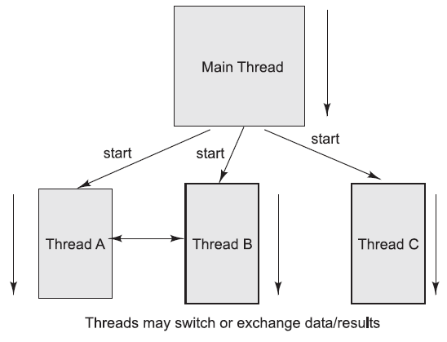
Program with master and children threads

Slide 3
Threads Concept
Multiple threads on multiple CPUs
Multiple threads sharing a single CPU

Slide 4
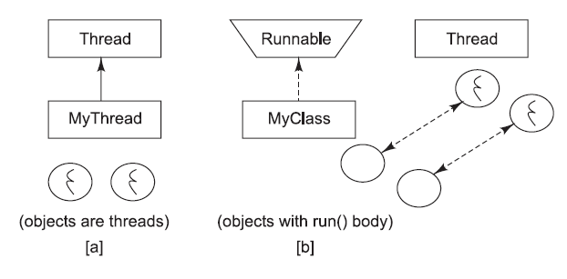
THREADS IN JAVA
Threads are objects in the Java language. They can be created by using two different mechanisms:
1. Create a class that extends the standard Thread class.
2. Create a class that implements the standard Runnable interface.

Slide 5
THREADS IN JAVA
Thread can be defined by:
Extending the java.lang.Thread class, or
Implementing the java.lang.Runnable interface.
The run() method should be overridden and should contain the code that will be executed by the new thread.
This method must be public with a void return type and should not take any arguments.

Slide 6
Extending the Thread Class
1. Create a class by extending the Thread class and override the run() method:
class MyThread extends Thread {
public void run() {
// thread body of execution
}
}
2. Create a thread object:
MyThread thr1 = new MyThread();
3. Start Execution of created thread:
thr1.start();

Slide 7
Example
/* ThreadEx1.java: A simple program creating and invoking a thread object by
extending the standard Thread class. */
class MyThread extends Thread {
public void run() {
System.out.println(“ this thread is running ... ”);
}
}
class ThreadEx1 {
public static void main(String [] args ) {
MyThread t = new MyThread();
t.start();
}
}

Slide 8
Implementing the Runnable Interface
1. Create a class that implements the interface Runnable and override run() method:
class MyThread implements Runnable {
…
public void run() {
// thread body of execution
}
}
2. Creating Object:
MyThread myObject = new MyThread();
3. Creating Thread Object:
Thread thr1 = new Thread(myObject);
4. Start Execution:
thr1.start();

Slide 9
Example
/* ThreadEx2.java: A simple program creating and invoking a thread object by
implementing Runnable interface. */
class MyThread implements Runnable {
public void run() {
System.out.println(“ this thread is running ... ”);
}
}
class ThreadEx2 {
public static void main(String [] args ) {
Thread t = new Thread(new MyThread());
t.start();
}
}

Slide 10
Life Cycle of Thread
new
start()
I/O completed
ready
resume()
Time expired/ interrupted
notify()
sleeping
blocked
waiting
dispatch
sleep()
wait()
suspend()
running
Block on I/O
completion
stop()
dead

Slide 11
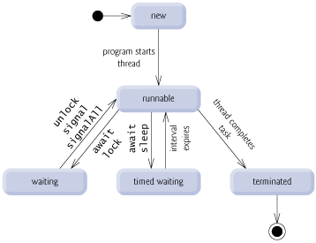
Thread States
http://www.deitel.com/articles/java_tutorials/20051126/JavaMultithreading_Tutorial_Part2.html

Slide 12
Thread States
A thread can be in one of five states: New, Ready, Running, Blocked, or Finished.

Slide 13
Thread termination
A thread becomes Not Runnable when one of these events occurs:
Its sleep method is invoked.
The thread calls the wait method to wait for a specific condition to be satisifed.
The thread is blocking on I/O.

Slide 14
Threads
Threads are lightweight processes as the overhead of switching between threads is less
They can be easily spawned
The Java Virtual Machine spawns a thread when your program is run called the Main Thread

Slide 15
Why do we need threads?
To enhance parallel processing
To increase response to the user
To utilize the idle time of the CPU
Prioritize your work depending on priority

Slide 16
Example
Consider a simple web server
The web server listens for request and serves it
If the web server was not multithreaded, the requests processing would be in a queue, thus increasing the response time and also might hang the server if there was a bad request.
By implementing in a multithreaded environment, the web server can serve multiple request simultaneously thus improving response time

Slide 17
Creating threads
In java threads can be created by extending the Thread class or implementing the Runnable Interface
It is more preferred to implement the Runnable Interface so that we can extend properties from other classes
Implement the run() method which is the starting point for thread execution

Slide 18
Running threads
Example
class mythread implements Runnable{
public void run(){
System.out.println(“Thread Started”);
}
}
class mainclass {
public static void main(String args[]){
Thread t = new Thread(new mythread()); // This is the way to instantiate a thread implementing runnable interface
t.start(); // starts the thread by running the run method
}
}
Calling t.run() does not start a thread, it is just a simple method call.
Creating an object does not create a thread, calling start() method creates the thread.

Slide 19
Synchronization
Synchronization is prevent data corruption
Synchronization allows only one thread to perform an operation on a object at a time.
If multiple threads require an access to an object, synchronization helps in maintaining consistency.

Slide 20
Example
public class Counter{
private int count = 0;
public int getCount(){
return count;
}
public setCount(int count){
this.count = count;
}
}
In this example, the counter tells how many an access has been made.
If a thread is accessing setCount and updating count and another thread is accessing getCount at the same time, there will be inconsistency in the value of count.

Slide 21
Fixing the example
public class Counter{
private static int count = 0;
public synchronized int getCount(){
return count;
}
public synchoronized setCount(int count){
this.count = count;
}
}
By adding the synchronized keyword we make sure that when one thread is in the setCount method the other threads are all in waiting state.

Slide 22
What about static methods?
public class Counter{
private int count = 0;
public static synchronized int getCount(){
return count;
}
public static synchronized setCount(int count){
this.count = count;
}
}
In this example the methods are static and hence are associated with the class and not the instance.
Hence the lock is placed on the class object that is, Counter.class object and not on the object itself. Any other non static synchronized methods are still available for access by other threads.

Slide 23
Common Synchronization mistake
public class Counter{
private int count = 0;
public static synchronized int getCount(){
return count;
}
public synchronized setCount(int count){
this.count = count;
}
}
The common mistake here is one method is static synchronized and another method is non static synchronized.
This makes a difference as locks are placed on two different objects. The class object and the instance and hence two different threads can access the methods simultaneously.

Slide 24
Thanks

